Slide 1
Technical Support (420-1N6-AB) Software: Operating Systems
Fall 2021

Slide 2
Outline
Introduction
History of Operating Systems
Available Operating Systems
Choosing an Operating System
Installing an Operating System
Running Multiple Operating Systems

Slide 3
Introduction

Slide 4
What is an Operating System?
An Operating Systems or OS, is a software that controls almost all functions on a computer.
OS is also known as the System Software.
Provides the interface for the interaction between users, applications and hardware.
Brainstorm
How many OS can you think of?
How many have you used? Where, Why?

Slide 5
OS Parts
Shell
The outer part of an operating system.
The interface between the user and the kernel, including all of the programs which the user interacts with
Kernel
Responsible for managing and controlling the computer hardware components.
Interacts with devices such as the processor, main memory, storage devices, input devices, output devices and communication devices.
Communicates with the firmware installed on connected devices (not with their circuitry directly) via device driver software

Slide 6
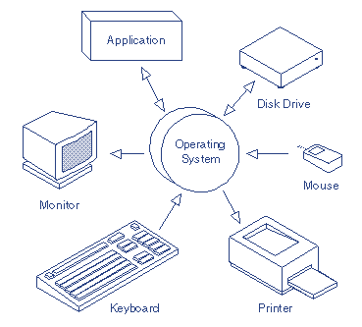
OS Basic Functions
Control Hardware Access
Manage Files and Folders.
Provide a User Interface.
Manage Applications

Slide 7
Hardware Access
OS uses a program called a device driver to communicate with each hardware component.
When a new hardware device is installed:
OS locates and installs the device driver for that component.
System resources are assigned and drivers are installed.
OS then configures the device and updates the registry.
If the OS cannot locate the driver, the user must install it manually from the media that came with the decide or by downloading it from the manufacturer’s website.

Slide 8
File and Folder Management
The OS creates a file structure on the hard drive to store data.
File: a block of related data that is given a single name and is treated as a single unit.
Example: word document “Assignment.docx”
Directory: a container to organize files and programs.
Directories can be nested (kept inside other directories) and are then called subdirectories.
The organization hierarchy facilitates the retrieval and use of files and other directories.

Slide 9
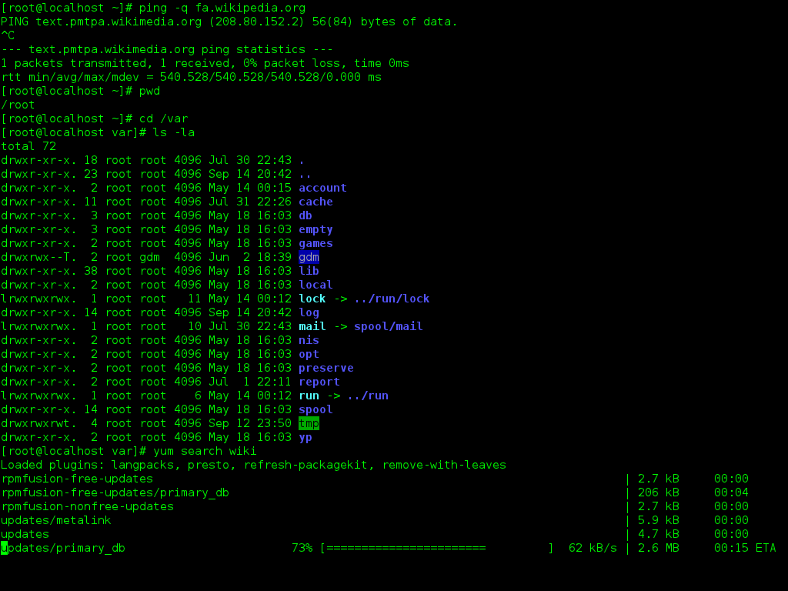
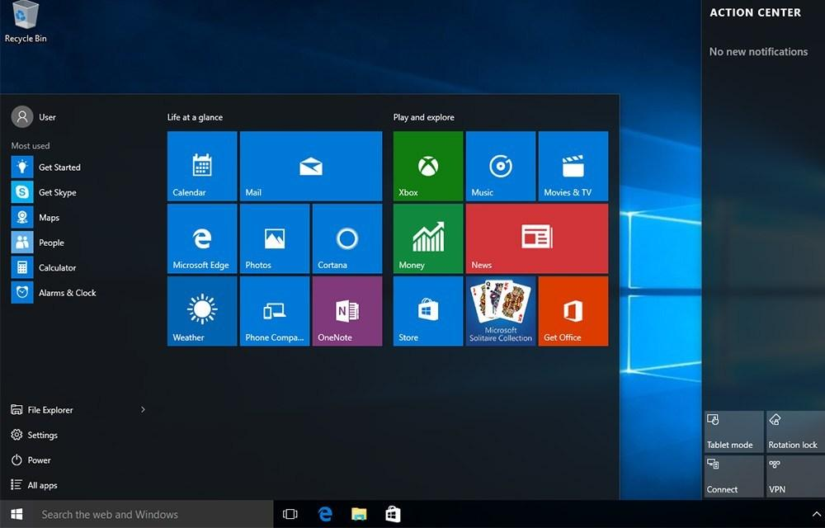
User Interface
The OS user interface enables the user to:
Interact with the software.
Control hardware.
OS include two types of user interfaces:
Command-line interface (CLI)
The user types commands at a prompt.
Graphical user interface (GUI)
The user interacts with menus and icons.

Slide 10
Application management
The OS locates an application and loads it into the RAM of the computer.
Applications are software programs such as word processors, databases, spreadsheets and games.
The OS allocates available system resources to running applications.
OS organizes usages of CPU among different applications.
Closed application processes will be removed from the RAM.

Slide 11
Operating System History

Slide 12
1940s & 1950s
1940s
Early computers did not include operating systems.
1950s
OS executed one “job” (process) at a time.
Included technologies to smooth job-to-job transitions.
Single-stream batch-processing systems.
Programs and data submitted consecutively on tape.

Slide 13
1960s & 1970s
Multitasking introduced: process multiple jobs at once.
One job could use the CPU while other jobs used peripheral devices.
Advanced operating systems developed to service multiple interactive users.
Timesharing systems
Developed to support many simultaneous interactive users.
Turnaround time was reduced to minutes or seconds.
Time between submission of job and the return of its results.
Introduced virtual memory.
More memory allocations than actually exist.
Personal computing only in incipient stages.
Fostered by early developments in microprocessor technology.

Slide 14
1980s
Decade of personal computers and workstations.
Personal computers proved relatively easy to learn and use.
Graphical user interfaces (GUI).
Transferring information between computers via networks became more economical and practical.
Client/server computing model spread widely:
Clients request various services.
Servers perform requested services.

Slide 15
1990s
Operating system support for networking tasks became standard.
Increased productivity and communication.
Operating systems became increasingly user friendly
GUI features improved and widely used.
“Plug-and-play” capabilities built into operating systems.
Enable users to add and remove hardware components dynamically.
No need to manually reconfigure operating system .
Enabled users to navigate multiple concurrent applications.

Slide 16
2000s & Beyond
OS with middleware
Links two separate applications
Provides services to software applications beyond those available from the operating system.
Particularly important for Web services
Simplifies communication across multiple architectures.
Enable any two applications to communicate and exchange data over the web.
Web-Oriented
Depends on web-applications
Software application that runs in the web browser.
Server process the data based on client request and provide response.

Slide 17
Available Operating Systems

Slide 18
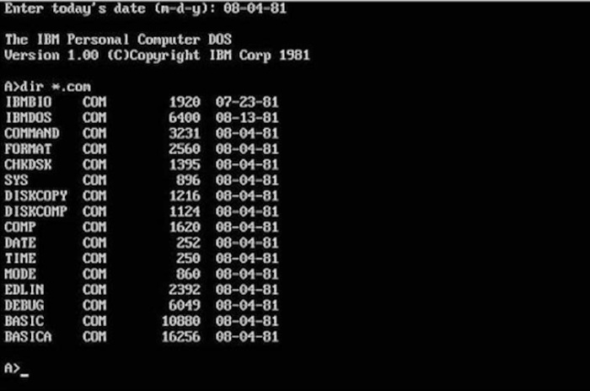
Microsoft DOS (Disk Operating System)
Single-user operating system developed by Microsoft.
First widely-installed operating system for personal computers.
CLI (Command Line Interface) based.
MS Windows still uses some of the commands.
Underlying control program for later operating systems: Windows 3.1, 95, 98 and ME.

Slide 19
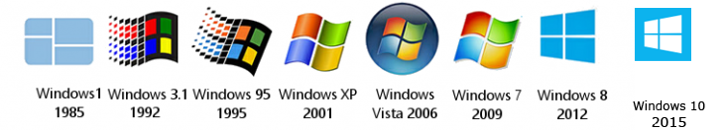
Microsoft Windows
Most used operating system for personal and industry use.
Client version (Desktop) and Server version.
Graphical based operating system.
Window Server 2012 & 2016 have command line based versions only.
Windows evolution: https://www.versionmuseum.com/history-of/microsoft-windows

Slide 20
UNIX
UNIX was one of the first operating systems to be developed by AT&T in 1971.
Has been under constant development.
Closed-source OS.
The origin story of GNU/Linux: AT&T closed the license to Unix; GNU/Linux were essentially a rewrites on an open license.
GNU: the shell of the GNU/Linux OS (this is ~80% true, there are non-GNU components in the shells of most Linux OSs)
Linux: the kernel of the GNU/Linux OS
Most often, GNU/Linux is just called “Linux” (there’s a small controversy about this)
The original UNIX is still used in mission critical applications for client/server and transaction processing.
Very interesting ensuing development: “unix-like” or “*nix” systems are everywhere. Variants of unix-based systems include Linux, OS X, FreeBSD (see chart on next slide)

Slide 21
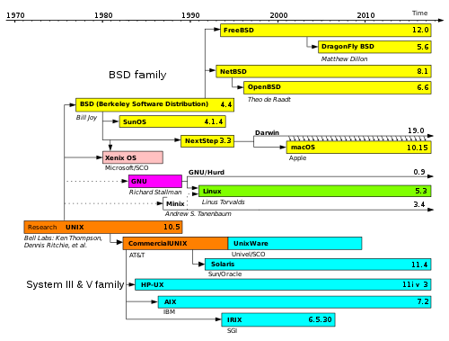
UNIX and the *nix family

Slide 22

GNU/Linux
GNU/Linux (commonly referred to as Linux) is free and open source.
The name “Linux” comes from the Linux kernel, started in 1991 by Linus Torvalds.
The name “GNU” is a recursive acronym, “GNU’s Not Unix” (GNU was the effort made by free software developers, famously Richard Stallman, to rewrite Unix from the ground up)
GNU/Linux is the combination of the GNU programs with the Linux kernel.
Known for its use in servers.
Widely used in a variety of computer hardware, including desktop computers, supercomputers, video game systems, and embedded devices such as mobile phones and routers.

Slide 23
Apple: Macintosh, OS x, macOS
Apple produced the first widely-sold computer with GUI, Mac computer, in 1984 with its own operating system.
Based off of the Berkley Software Distribution (BSD) *nix based operating system and license
Evolution: https://www.versionmuseum.com/history-of/mac-os-x

Slide 24

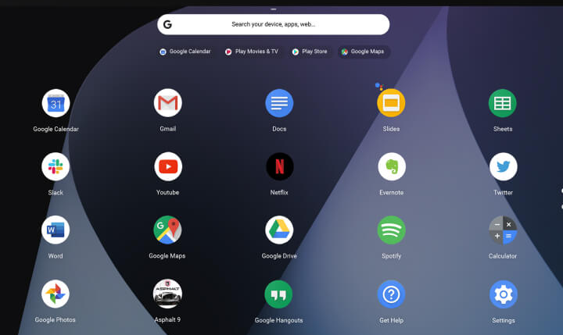
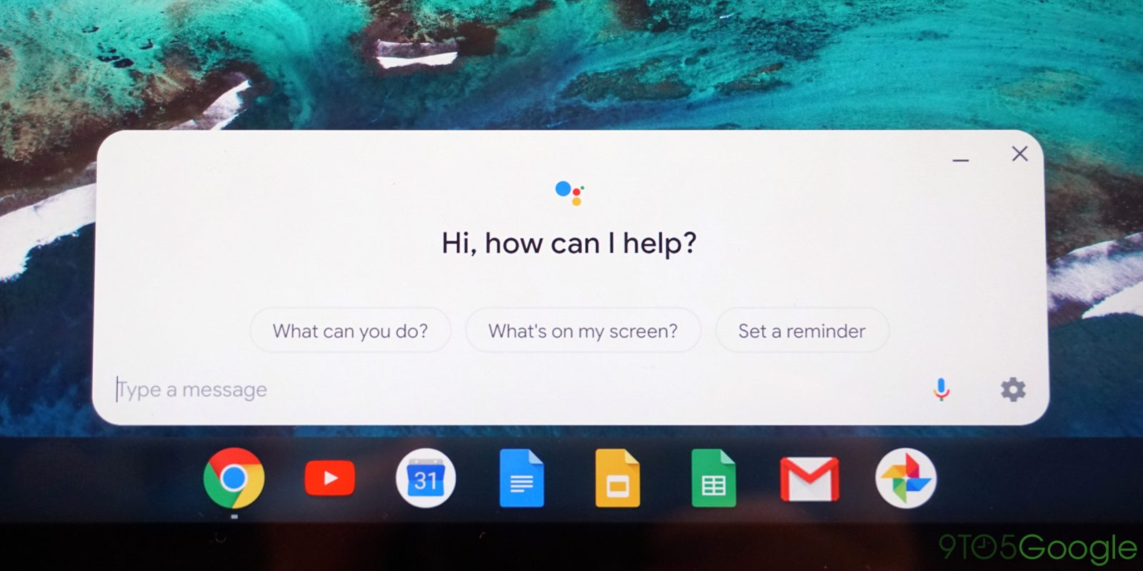
Chrome OS
Designed by Google in 2011.
A Linux kernel-based operating system.
Derived from the free software Chromium OS.
Uses the Google Chrome web browser as its principal user interface.
All its applications are web-centric.

Slide 25
PC Desktop OS Market Share Worldwide
Source: https://gs.statcounter.com/os-market-share/desktop/worldwide/#monthly-201808-201908-bar (Captured 12 September 2019)

Slide 26
Choosing An Operating System

Slide 27
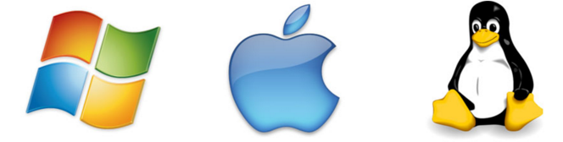
Which OS Should I install?
Choosing an OS is a significant decision.
Major decision factors include:
The intended use of the computer and its role in the network.
The applications and environments that will need to run.
The minimum hardware requirements of the operating systems.

Slide 28
Intended Use Of Computer
Desktop OS
Intended for home or small office environments with a limited number of users.
Runs single-user applications, shares files and folders with limited security.
Network OS
Designed for corporate environment serving multiple users with a wide range of needs.
Generally provide network resources including server applications, centralized data storage, network print queues, RAID and backup systems.

Slide 29
Compatible Applications and Environments
The OS you choose must be compatible with the existing hardware and the required applications.
Commercial applications usually specify a list of compatible operating systems on website or sold product.
For customized applications, the programmer should specify which operating systems can be used with.

Slide 30
Minimum Hardware Requirements
Operating systems (like all other software applications) have minimum hardware requirements that must be met.
Why?
To be able to install the OS.
For the OS to function correctly.
For the OS to run smoothly (no lagging or freezing).
To examine OS requirements it is best to visit the developer’s website.
Example: Microsoft’s online compatibility center (Windows 10).

Slide 31
Installing an Operating System

Slide 32
Clean Installation
A clean installation is an installation where the target disk partition is erased prior to actual installation.
A clean installation should be carried out:
When a computer is passed from one person to another.
When the OS that was installed is corrupt.
When the primary hard drive has been replaced.
A clean installation often succeeds where an unclean installation may fail. WHY?

Slide 33
How to Install an OS
OS installation can start by booting from a media that holds the operating system files. (The media has to be bootable ready)
Bootable media include:
CD or DVD operating system disk (used to be most common method)
Bootable USB flash drive.
Network boot: operating system file will be placed in on a server. Installation will happen over the network.
Prior to installation, you have to setup the computer BIOS/UIEF to boot from the proper device. (e.g. USB or DVD)

Slide 34
After booting from Media
The first phase of the installation process will partition and format the hard drive.
This step prepares the disk to accept the new file system (the directory structure).
Different operating systems use different file systems.

Slide 35
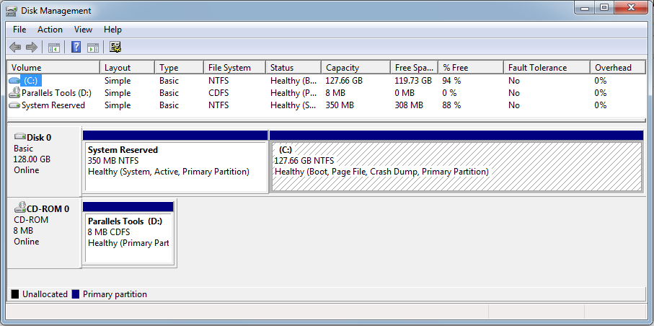
Partitioning
The process of subdividing the physical hard drive into smaller units each known as a partition.
A hard drive must have at least one partition.
Windows: Each partition is assigned a drive letter such as C: or D:

Slide 36
Partitioning Advantages
Partitions provide flexibility for hard drive organization.
Isolating OS files:
Keeping the OS, applications and data on the same partition is risky because if something happens to the partition's index file, you won't be able to boot up or even access the rest of the data on that partition.
If you keep your operating system and applications in a different partition to your data (documents, photos, music, etc.) the data will be easier to back up.
The OS partition can be formatted without affecting any data.
Partitioning allows users to install multiple OSs.
Each OS will be installed on a partition.

Slide 37
Formatting
Formatting is the process of creating a file system and making the root directory in that file system.
It organizes the partition so the OS can store files and folders on it.
Each partition on the disk must be formatted before it can hold data.

Slide 38
File System: Windows
NTFS (New Technology File System)
Support partition sizes up to 16 exabytes (in theory).
More file system security features and extended attributes than the FAT file system.
FAT32 (File Allocation Table 32-bit)
Support partition sizes up to 2 terabytes.
Limits data file size to 4 GB.
Used by Windows XP and older OS versions.

Slide 39
Data Migration
When a new installation is required, user data might need to be migrated from the old OS to the new one.
There are various tools available to transfer data and settings:
Windows User State Migration Tool (USMT)
Includes user accounts, user files, operating system settings, and application settings.
Cloud Solutions.
Physical Solutions:
External Drive.
Transfer cables.
Windows Easy Transfer
Old tool by Microsoft for transferring from Windows XP (32 bit) to Windows 7.

Slide 40
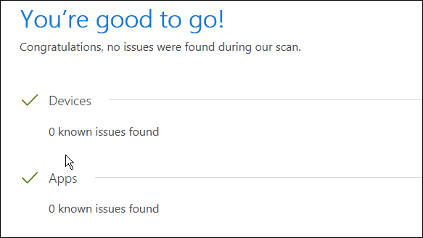
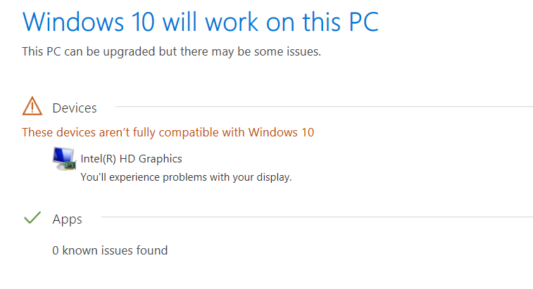
Upgrading An Operating System
Microsoft provides a free utility which scans the system for hardware and software incompatibility issues before allowing you to upgrade to newer versions of Windows operating systems.

Slide 41
Running Multiple Operating Systems

Slide 42
Multiple Operating Systems
Commercial computers usually come an OS pre-loaded on the disk.
Most users use the operating system that comes with their computer.
It is possible to upgrade, change or add an another operating system.
The three most common operating systems for personal computers are Microsoft Windows, macOS, and Linux.

Slide 43
Why Multiple Operating Systems?
Learn about another operating systems.
Users can experiment with Linux, but will retain access to Windows OS.
More application software
Some application are developed for special platforms.
Testing software
Applications developed for multiple OSs can be natively tested.
Web designers test sites in various OSs using native browsers.
Running older/multiple versions of an operating system.
Drivers for legacy hardware are unavailable (e.g. scanners).
IT staff may need to be able to work with several versions of Windows.
Reduce space dedicated for computer hardware in a working environments.
Gamers don't want to endanger their business installation. ☺

Slide 44
Issues with Running Multiple Operating Systems
Disk space
Perhaps the biggest factor when setting up multiple operating systems on a personal computer is the available disk space.
Running multiple operating systems means the need to allocate space for each operating system and each systems file storage.
Switching between operating systems
User tend to find hard to move the work environment between multiple OSs (running application and files).

Slide 45
Running Multiple Operating Systems
There are two different ways to run multiple operating systems on the same computer:
Dual boot
Virtualization

Slide 46
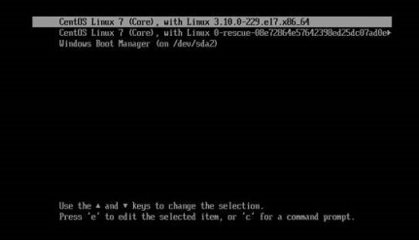
Dual Booting
Dual booting indicates installing a second operating system on a separate partition of a hard drive.
On boot, a prompt will allow the user to choose the OS.
To switch the OS, a reboot is required.

Slide 47
Dual Booting (cont.)
Dual booting has the advantage that OSs will be running natively.
The loaded OS will be the only OS running.
Uses all available CPU and memory.
Results in a better performance and smoother operation.
Accessing files can be problematic due to different file systems.

Slide 48
Virtualization
Virtualization allows to run multiple instances of different operating systems concurrently.
The host OS will run an virtualization software that provides functionality to run other operating systems virtually.
Known as virtual machines or virtual boxes.
A virtual machine runs to emulate an operating system in a window.
Operating systems do not interfere with each other or the various applications.
Virtual machines share CPU, memory, disk space and other hardware components with host OS and other virtual machines.

Slide 49
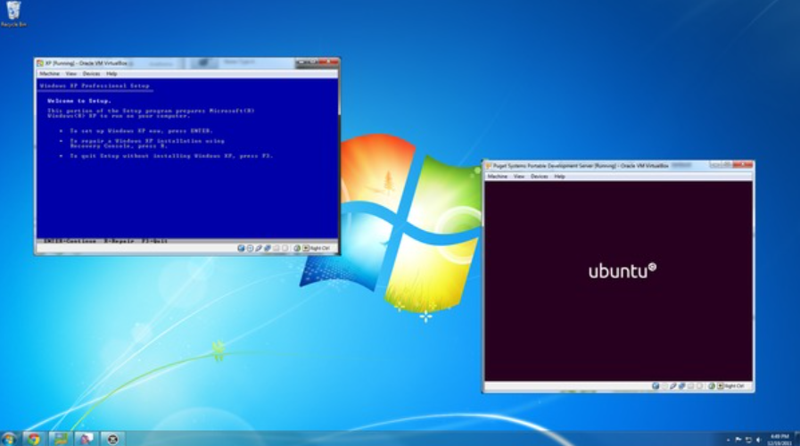
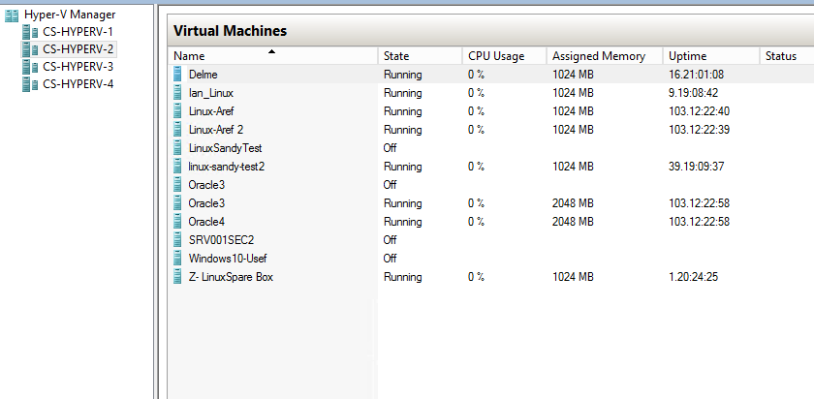
Virtualization (cont.)
Virtualization provides easier access to files and programs in the host OS.
Commonly used by businesses as switching between OSs is easy.
With high specs servers, business are moving towards having different virtual machines for different tasks.

Slide 50
Q & A
Notes:
In Slide Show mode, click the arrow to enter the PowerPoint Getting Started Center.

